Slide 1
Speaking With Influence
by
Intellectual Property Owners Association
Women In IP Committee
Push Forward Subcommittee

Slide 2
Overview
Differences in Communication Styles
Gender Stereotypes
What Can Employers Do?
What Can Employees Do?
Questions

Slide 3
Differences in Communication Styles

Slide 4
Gender Stereotypes Can Have Negative Effects
Stereotypes in gender roles have negative effects on women’s behaviors and perceptions of women in the workplace
Consequences include unequal pay and lack of promotions
Stereotypes are engrained at a young age and reinforced throughout our lives
http://www.todaysworkplace.org/2006/12/01/gender-stereotyping-in-the-workplace-and-the-discrimination-it-creates-danica-dodds/

Slide 5
Common Gender Stereotypes
Women are taught to downplay achievements
Women are commonly stereotyped as:
Emotional, Friendly, Sympathetic, Sensitive, Cheerful, Irrational, Collaborative
Men are commonly stereotyped as:
Dominant, Forceful, Aggressive, Self-Confident, Rational, Unemotional
While all stereotypes are just that, common stereotypes about women are traits that may be undesirable in the workplace
“Women ‘Take Care’, Men ‘Take Charge:’ Stereotyping of U.S. Business Leaders Exposed”, Catalyst, 2005, Table 1

Slide 6
Stereotypes in Communication
Softening
“When you get a chance, will you please…”
“I think….”
“If you don’t mind….”
Downplaying Achievements
“We” rather than “I”
Apologizing
“I’m sorry”

Slide 7
What Can Employers Do To Support Women in Speaking with Influence?

Slide 8
Facilitate Informal Interactions
Take time to get to know co-workers, superiors and clients
The more women push themselves to create deeper relationships, the better these relationships will work for them
Create other informal settings for men and women to interact (e.g., lunch) to discuss business issues in a more relaxed setting
This helps women and men share perspectives and hash out issues so when both reach the conference room there's a shared sense of support and more well-rounded solutions and decisions are made

Slide 9
Institute a No-Interruption Rule
When someone has the floor, whether male or female, they are not to be interrupted

Slide 10
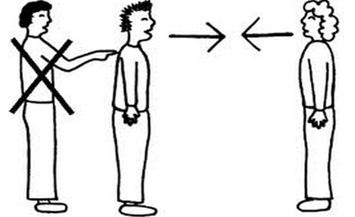
Stop an Interrupter and Speak Up
“I want to hear what she is saying” or
“I’d like her to be able to finish her point”
These are polite ways to point out the behavior while showing support for a female colleague that can bolster her confidence

Slide 11
Adopt Practices that Focus More on the Idea and Less on the Speaker
Allow employees to submit suggestions and solutions to problems anonymously
Proposals can be evaluated, feedback can be given to participants, and then the best plans can be implemented
This can encourage women to present their ideas without the fear of interruption or having their ideas publicly dismissed

Slide 12
Include Women in the Discussion
In a meeting, ask women -“What do you think?”
Ask for feedback as opposed to dictating
The “Shine A Light” process was pioneered by the Obama White House staff and other organizations. This process offers practical tools for leaders who want to validate and support contributions of women.

Slide 13
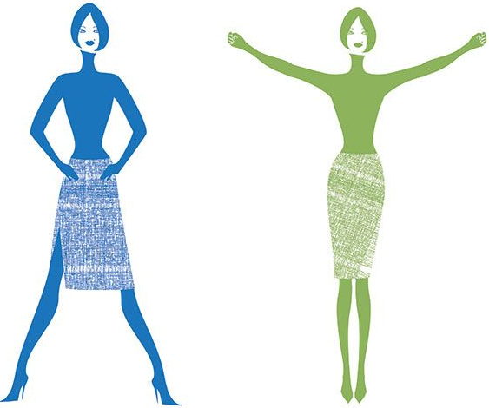
What Can Employees do to Support Women to Speak with Influence?

Slide 14
Be Prepared
Arrive at a meeting with key discussion points
Focus on “what does the audience need to hear” rather than “what am I going to say”

Slide 15
Delivery Tips
Speak using statements
Women have a tendency to couch their input. This can work against them by weakening their legitimate points
Use active, authoritative words and statements when voicing and owning your opinions
Try saying “I strongly suggest…” instead of “Well, what if…”

Slide 16
Delivery Tips
Get to the point
Women run the risk of losing their audience’s attention and their own authority by over-explaining
Drop the defensiveness
Responding defensively when decisions are questioned is generally an attempt to protect authority; however, it will actually make women come across as less confident and less in charge

Slide 17
Questions?

Slide 18
Special Thanks
With special thanks to IPO’s Women in IP “Push Forward” Subcommittee Members who contributed to the content of this presentation:
Shruti Costales (Subcommittee Chair), HP Inc.
Emma Bienias, Stout Risius Ross
Rachael Rodman, Dinsmore
Eve Frank, Bristol-Myers Squibb
Lonnie Rosenwald, Intellectual Ventures
Karen Weil, Knobbe Martens, Olsen & Bear
Sandra Nowak, 3M

