Slide 1

Implicit Bias
&
Ethical Duties of Lawyers
IPO Annual Meeting
17-19 September 2017
San Francisco, CA
Shruti Costales, HP Inc. (Moderator)
Paola Cecchi-DiMeglio, Harvard University
Henry Hadad, Bristol-Myers Squibb
Andrea Kramer, McDermott Will & Emery
Bismarck Myrick, United States Patent and Trademark Office

Slide 2

Agenda
What is Implicit Bias?
Why are we talking about Implicit Bias?
How do you spot Implicit Bias?
How can we de-bias?
Conclusions
Questions

Slide 3
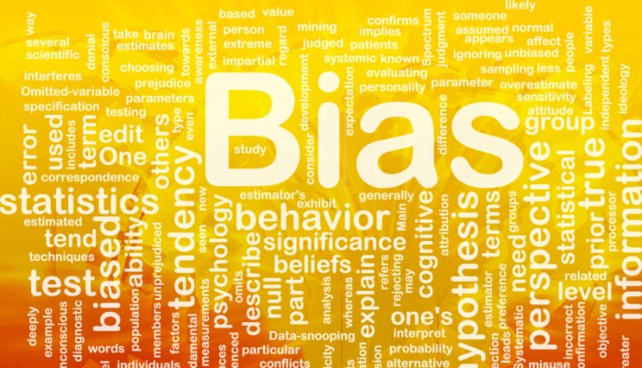
What is Implicit Bias?

Slide 4
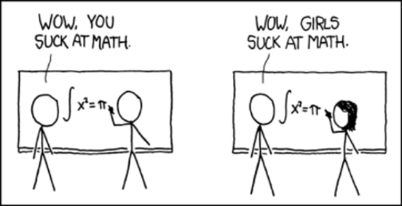
What is Implicit Bias?
Attitudes or stereotypes that affect our understanding, actions, and decisions in an unconscious manner.

Slide 5
What is Implicit Bias?
Refers to the biases (beliefs, attitudes, behaviors) over which we have no conscious control and which are not accessible through introspection.
They occur automatically and are triggered by our brain making quick judgments and assessments of people and situations.
They encompass both favorable and unfavorable assessments and preferences.
Hidden biases influence our behavior towards others without us realizing it.
Everyone is susceptible to unconscious/implicit biases.

Slide 6

Characteristics that Trigger Bias
Race
Sex
Age
Ethnicity
Language
Culture
Socioeconomic
Religion
Skin Color
Weight
Sexuality
Gender Identity
National Origin
Disability
Political View
Profession
Marital Status
Physical Attractiveness
Height
Class

Slide 7

How does it work?
The unconscious processing abilities of the human brain are estimated at roughly 11 million bits of information per second.
Compare that to the estimate for conscious processing: about 40 bits of information per second.

Slide 8

How does it work?
The brain seeks to conserve energy.
Decision-making, problem-solving, ambiguity, and novelty take heavy cognitive reserves.
Humans have evolved to have mental shortcuts that save time and yield reliable results to make sense of their environment.

Slide 9
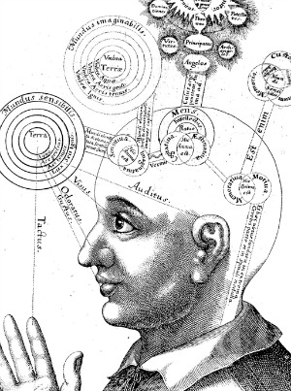
Examples of Triggering Factors for Implicit Bias
Stress
Time constraints
Multi-tasking
Need for closure

Slide 10

Characteristics of Implicit Bias
A normal part of the human experience.
Our biases may not be aligned with our declared beliefs.
We tend to have preferences for those who share similar characteristics.

Slide 11
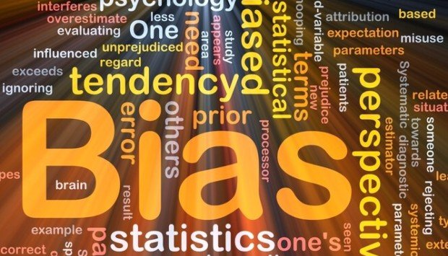
Awareness
Bias had been believed to be intentional & conscious but today we understand it as unconscious & unintentional
Social cognition theory establishes that mental categories and personal experiences become “hardwired” into cognitive functioning
Bias can be seen as evolutionary adaptive behavior
Biases can change over time

Slide 12

Why are we talking about Implicit Bias here?

Slide 13

Top Reasons Women and Minorities are Leaving Law Firms or the Legal Profession
Lack of mentorship/sponsorship
Unsatisfying upward mobility
Limited meaningful work
Wage gap
Vague Feedback
Lack of work-life balance
All the above can be traced back to biases and/or discrimination

Slide 14
Why Everyone Should Care about Women & Minorities Leaving the Legal Profession
Corporate Legal Departments are demanding that outside counsel meet certain diversity metrics.
  HP Inc. General Counsel – Kim Rivera’s mandate – “HP has informed its outside law firms that the company may withhold up to 10 percent of invoiced fees for failure to meet its diversity standards.” (See http://www.abajournal.com/news/article/hp_general_counsel_tells_law_firms_to_meet_diversity_mandate_or_forfeit_up/).
  Facebook’s General Counsel – Colin Stretch requires that women and ethnic minorities account for at least 33 percent of law firm teams working on its matters. (See https://www.nytimes.com/2017/04/02/business/dealbook/facebook-pushes-outside-law-firms-to-become-more-diverse.html).

Slide 15
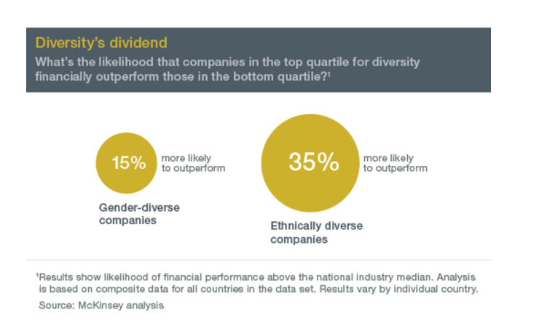
Why Everyone Should Care

Slide 16
Demographics – Women in Law Schools
Source: https://www.americanbar.org/content/dam/aba/marketing/women/current_glance_statistics_january2017.authcheckdam.pdf

Slide 17
Demographics – Women in the Legal Profession (2016)
Source: https://www.americanbar.org/content/dam/aba/marketing/women/current_glance_statistics_january2017.authcheckdam.pdf

Slide 18
Demographics – Women in Private Practice
(2015-2016)
Source: https://www.americanbar.org/content/dam/aba/marketing/women/current_glance_statistics_january2017.authcheckdam.pdf

Slide 19
Demographics – Women in Corporations (2016)
Fortune 500 General Counsel Fortune 501-1000 General Counsel
Source: https://www.americanbar.org/content/dam/aba/marketing/women/current_glance_statistics_january2017.authcheckdam.pdf

Slide 20
Demographics – Women & Minorities in Law Firms – 2009-2016
Source: http://www.nalp.org/uploads/Membership/2016NALPReportonDiversityinUSLawFirms.pdf

Slide 21
Demographics – Partners & Associates at Law Firms – 2009-2016
Source: http://www.nalp.org/uploads/Membership/2016NALPReportonDiversityinUSLawFirms.pdf

Slide 22
Demographics – Lawyers with Disabilities -2016
Source: http://www.nalp.org/uploads/Membership/2016NALPReportonDiversityinUSLawFirms.pdf

Slide 23
Demographics – Openly LGBT Lawyers - 2016
Source: http://www.nalp.org/uploads/Membership/2016NALPReportonDiversityinUSLawFirms.pdf

Slide 24
Wage Gap - Weekly Salary Men vs. Women Lawyers
Source: https://www.americanbar.org/content/dam/aba/marketing/women/current_glance_statistics_january2017.authcheckdam.pdf

Slide 25
Wage Gap – Weekly Salary vs. Women Lawyers
Source: https://www.americanbar.org/content/dam/aba/marketing/women/current_glance_statistics_january2017.authcheckdam.pdf

Slide 26
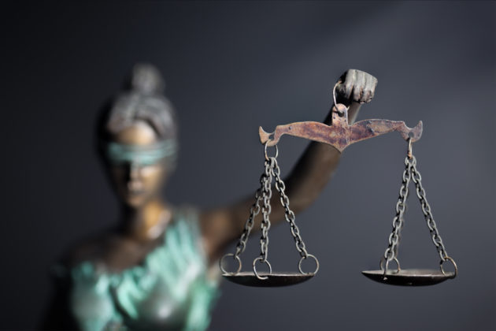
Laws & Rules to Consider

Slide 27
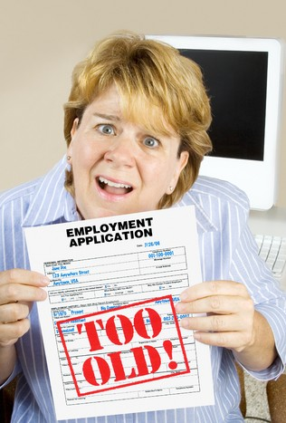
Age Discrimination in Employment Act of 1967
The Age Discrimination in Employment Act of 1967 (ADEA) protects certain applicants and employees 40 years of age and older from discrimination on the basis of age in hiring, promotion, discharge, compensation, or terms, conditions or privileges of employment.

Slide 28

Title VII of the Civil Rights Act of 1964
Title VII of the Civil Rights Act of 1964 is a federal law that prohibits employers from discriminating against employees on the basis of sex, race, color, national origin, and religion. It generally applies to employers with 15 or more employees, including federal, state, and local governments.

Slide 29

The Americans with Disabilities Act of 1990
The Americans with Disabilities Act of 1990 (ADA) prohibits discrimination and ensures equal opportunity for persons with disabilities in employment, state and local government services, public accommodations, commercial facilities, and transportation. It also mandates the establishment of TDD/telephone relay services. The ADA was revised by the ADA Amendments Act of 2008 (P.L. 110-325), which became effective on January 1, 2009. The ADA is codified at 42 U.S.C. 12101 et seq.

Slide 30

Family and Medical Leave Act of 1993
The Family and Medical Leave Act of 1993 (FMLA) is a United States federal law requiring covered employers to provide employees with job-protected and unpaid leave for qualified medical and family reasons.

Slide 31
ABA Model Rule 8.4(g)
On August 8, 2016, the American Bar Association adopted the following rule:
It is professional misconduct for a lawyer to:
(g) engage in conduct that the lawyer knows or reasonably should know is harassment or discrimination on the basis of race, sex, religion, national origin, ethnicity, disability, age, sexual orientation, gender identity, marital status or socioeconomic status in conduct related to the practice of law. This paragraph does not limit the ability of a lawyer to accept, decline or withdraw from a representation in accordance with Rule 1.16. This paragraph does not preclude legitimate advice or advocacy consistent with these Rules.

Slide 32
ABA Model Rule 8.4(d)
It is professional misconduct for a lawyer to:
(d) engage in conduct that is prejudicial to the administration of justice;

Slide 33
ABA Model Rule 8.4 – Comment [3]
Comments [3] through [5] were also added on August 8, 2016.
Comment [3] provides:
[3] A lawyer who, in the course of representing a client, knowingly manifests by words or conduct, bias or prejudice based upon race, sex, religion, national origin, disability, age, sexual orientation or socioeconomic status, violates paragraph (d) when such actions are prejudicial to the administration of justice. Legitimate advocacy respecting the foregoing factors does not violate paragraph (d). A trial judge’s finding that peremptory challenges were exercised on a discriminatory basis does not alone establish a violation of this rule.

Slide 34

ABA Model Rule 8.4(g) – Is it New?
New section (g) builds on prior ABA policy. The Model Code of Judicial Conduct (2007) already contains anti-harassment and anti-discrimination provisions.

Slide 35
ABA Model Rule 8.4 – Is it difficult to enforce?
Lawyer McGrath sent two ex parte communications to judge disparaging the opposing party on the basis of national origin and immigration status. In re Disciplinary Proceedings against McGrath, 280 P.3d 1091 [Wash. 2012].
  By communicating or attempting to communicate ex parte on one or more occasions with Bankruptcy Court Judge without authorization to do so by law or court order, McGrath violated MRPC 3.5(b) (Impartiality and Decorum of the Tribunal), MRPC 8.4(a) (Prohibiting Violation or Attempted Violation of the RPC), and/or MRPC 8.4(d).
  Pattern of misconduct led to disbarment.

Slide 36
ABA Model Rule 8.4 – Is it difficult to enforce? (contd.)
Lawyer Williams made anti-Semitic remarks to opposing counsel at deposition; rules violated because Williams went beyond right to represent his clients vigorously, aggressively, and zealously. In re Williams, 414 N.W.2d 394 (Minn. 1987).
  Minnesota Rules of Professional Conduct - 3.5(h), 4.4, and 8.4(d) were found violated among other rules. [8.4(d) in Minnesota is the same as the MRPC 8.4(d)].
  Public reprimand and 6 months suspension.

Slide 37
ABA Model Rule 8.4 – Is it difficult to enforce? (contd.)
Lawyer accused prosecutor of hiding true identity as granddaughter of former Dominican Republic dictator Rafael Tujillo; filing motion with “false statement and unnecessary and offensive references to ancestry.” United States v. Kouri-Perez et al., 8 F. Supp. 2d 133 (D.P.R. 1998).
  MRPC 3.5(c) and 8.4(d) were found violated among other rules.
  Monetary sanctions.

Slide 38
Some States have Adopted Anti-discrimination / Anti-harassment Rules
25 jurisdictions have adopted some form of anti-discrimination / anti-harassment black letter rules.
13 jurisdictions of the 25 have adopted the language from the previous Comment 3 of Model Rule 8.4.

Slide 39
Professional Conduct Rules similar to ABA Model Rule 8.4(g)
California:
Rule 2-400:
(B) In the management or operation of a law practice, a member shall not unlawfully discriminate or knowingly permit unlawful discrimination on the basis of race , national origin, sex, sexual orientation, religion, age or disability in:
(1) hiring, promoting, discharging, or otherwise determining the conditions of employment of any person; or
(2) accepting or terminating representation of any client.

Slide 40
Professional Conduct Rules similar to ABA Model Rule 8.4(g)
New York:
Rule 8.4:
A lawyer or law firm shall not:
(g) unlawfully discriminate in the practice of law, including in hiring, promoting or otherwise determining conditions of employment on the basis of age, race, creed, color, national origin, sex, disability, marital status or sexual orientation. Where there is a tribunal with jurisdiction to hear a complaint, if timely brought, other than a Departmental Disciplinary Committee, a complaint based on unlawful discrimination shall be brought before such tribunal in the first instance. A certified copy of a determination by such a tribunal, which has become final and enforceable and as to which the right to judicial or appellate review has been exhausted, finding that the lawyer has engaged in an unlawful discriminatory practice shall constitute prima facie evidence of professional misconduct in a disciplinary proceeding.

Slide 41
Professional Conduct Rules similar to ABA Model Rule 8.4(g)
Illinois:
Rule 8.4:
It is professional misconduct for a lawyer to:
(j) violate a federal, state or local statute or ordinance that prohibits discrimination based on race, sex, religion, national origin, disability, age, sexual orientation or socioeconomic status by conduct that reflects adversely on the lawyer’s fitness as a lawyer. Whether a discriminatory act reflects adversely on a lawyer’s fitness as a lawyer shall be determined after consideration of all the circumstances, including: the seriousness of the act; whether the lawyer knew that the act was prohibited by statute or ordinance; whether the act was part of a pattern of prohibited conduct; and whether the act was committed in connection with the lawyer’s professional activities. No charge of professional misconduct may be brought pursuant to this paragraph until a court or administrative agency of competent jurisdiction has found that the lawyer has engaged in an unlawful discriminatory act, and the finding of the court or administrative agency has become final and enforceable and any right of judicial review has been exhausted.

Slide 42
Professional Conduct Rules similar to ABA Model Rule 8.4(g)
District of Columbia:
Rule 8.4:
It is a professional misconduct for a lawyer to:
(d) Engage in conduct that seriously interferes with the administration of justice.
Comment:
[3] A lawyer violates paragraph (d) by offensive, abusive, or harassing conduct that seriously interferes with the administration of justice. Such conduct may include words or actions that manifest bias or prejudice based upon race, sex, religion, national origin, disability, age, sexual orientation, or socioeconomic status.

Slide 43

Economic Impact
A 2014 report conducted by Right Profile and JD Match concluded the following:
  When an attorney leaves a firm, the cost to the firm ranges from $400,000 to more than $800,000 (for experienced attorneys).
  Turnover costs the legal industry roughly $9.1 billion annually in just the 400 largest firms in the U.S.
The cost of replacing a female lawyer is higher than the cost of replacing a male counterpart. The range varied based on the practice group the attorney belonged to, but the differential is about 10 percent for junior and senior associates and 20 percent for partners. (Source: P. Cecchi Dimeglio (2017), What it Costs When Talent Walks Out Your Door).
The time required for replacing a male lawyer ranges from six to 11 months. Replacing a female lawyer requires seven to 14 months. (Source: P. Cecchi Dimeglio (2017), What it Costs When Talent Walks Out Your Door).

Slide 44

Economic Impact
A 2014 report conducted by Right Profile and JD Match concluded that:
  $250,000 – is the cost to recruit one 1st year associate
  $400,000 – is the cost to firm when associate leaves
  17% annual attorney attrition rate for law firms
  46% entry-level associates leave law firm within 3 years
  81% entry-level associates leave law firm within 5 years

Slide 45

Negative Impact in the Workplace
Resumes with Caucasian-sounding names were about 50% more likely to receive callbacks for interviews than were resumes with African-American-sounding names.
Women receive more vague feedback and more negative criticism compared with men.

Slide 46
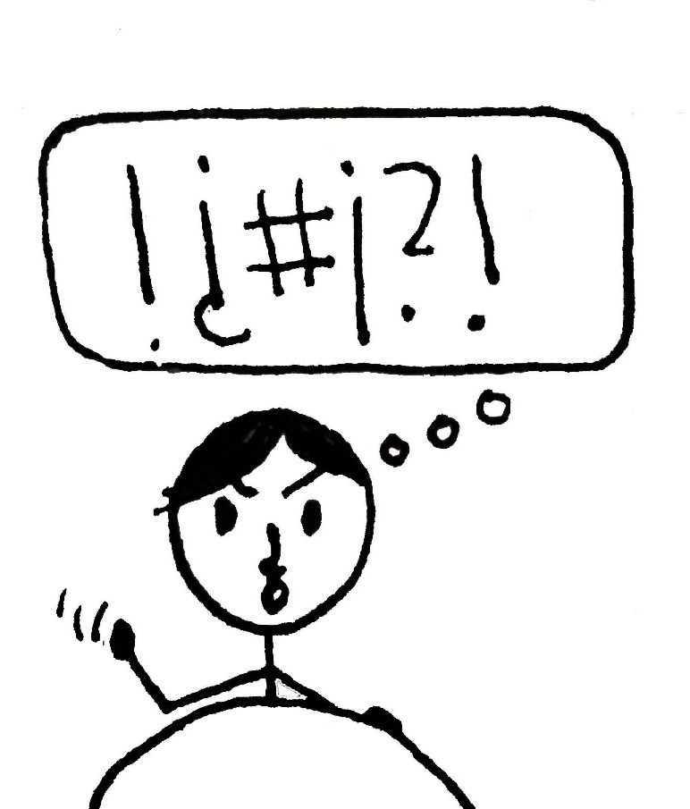
Vague and/or Negative Feedback
In a report for Fortune.com, 248 performance reviews were collected from 28 companies from large technology corporations to small startups.
The reviews came from 180 male and female managers.
Source: https://www.fastcompany.com/3034895/strong-female-lead/the-one-word-men-never-see-in-their-performance-reviews

Slide 47
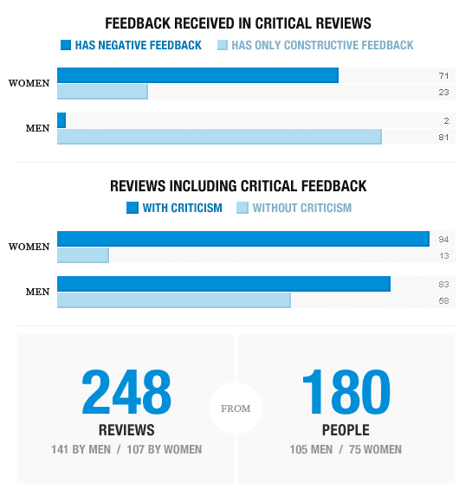
Vague and/or Negative Feedback
Source: https://www.fastcompany.com/3034895/strong-female-lead/the-one-word-men-never-see-in-their-performance-reviews

Slide 48
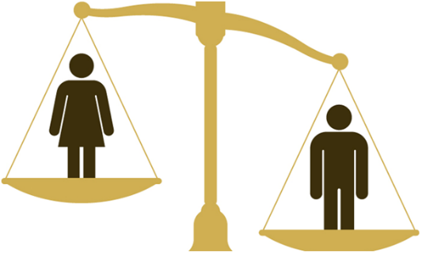
Gender Bias in Performance Reviews
The annual performance review has many strikes against it.
  Harried managers end up recalling high and low points on the fly.
  Employees often get unclear direction.
  Women are shortchanged by these reviews.
    For example, according to collected data, women’s performance was more likely to be attributed to characteristics such as luck or their ability to spend long hours in the office, perceived as real commitment to the firm, rather than their abilities and skills. As such, women often did not receive due credit for their work. (P.Cecchi-Dimeglio,2017)
    See https://hbr.org/2017/04/how-gender-bias-corrupts-performance-reviews-and-what-to-do-about-it.
    See also https://hbr.org/2016/04/research-vague-feedback-is-holding-women-back.

Slide 49

Gender Bias in the Selection Process: The Blind Audition
In 1970, the top five orchestras in the U.S. had less than 5% women.
After acknowledging the problem, orchestras began using blind auditions in the late 1970s and 1980s.
Candidates performed behind a screen for a jury that could not see them.
Some orchestras used blind auditions for preliminary selections while others used it until a hiring decision was made.

Slide 50
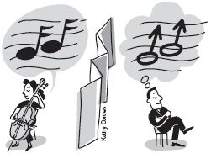
Results of Using A Screen
By 1980 the number of female musicians selected doubled to 10%.
By 1997 the number of female musicians selected was up to 25%.
The use of screens increased by 50% the probability of a woman advancing out of preliminary rounds of an audition.
The use of screens increased by 300% the probability of a woman getting selected when a screen was used for the final round.
The overall effect of blind auditions has increased the presence of women in US orchestras from about a 5% representation to between 40% and 50%.

Slide 51

Gender Bias in Hiring – A Study
Yale University researchers created a fictional student applying for a laboratory manager position and sent out the student’s application to 127 randomly selected science professors at top, research-intensive universities in the United States.
The professors were asked to:
  Evaluate competency of the student,
  Select a starting salary, and
  Whether they would be willing to hire and mentor the student.
All of the applications sent out were identical EXCEPT that half received an application from “Jennifer” while the other half received an application from “John.”

Slide 52
Experiment Results
John (Male)
Rated 4 out of 7 for competence.
Average starting salary: $30,328.
Seen more favorably as someone they might hire.
Seen more favorably as someone they would be willing to mentor.
Jennifer (Female)
Rated 3.3 out of 7 for competence.
Average starting salary: $26,508.
Seen less favorably as someone they might hire.
Seen less favorably as someone they would be willing to mentor.

Slide 53
Race Bias in Performance Review Process: The Legal Memo Study
Study involved legal memo which had 22 errors. Seven were minor spelling or grammar errors, six were substantive technical writing errors, five were errors in fact, and four were errors in the analysis of the facts.
60 partners from 22 law firms who agreed to participate in a “writing analysis study” received copies of the memo. 23 were women, 37 were men, 21 were racial/ethnic minorities, and 39 were white.
Half of the partners were told the memo was written by a Black 3rd year associate named Thomas Meyer, and the other half were told the writer was a White 3rd year associate named Thomas Meyer.

Slide 54
Experiment Results
Thomas Meyer (White)
The memo was rated 4.1 out of 5.
Rated generally a good writer.
Reviewers found an average of 2.9 out of 7 spelling and grammar errors.
“Has potential” and “good analytical skills.”
Thomas Meyer (Black)
The memo was rated 3.2 out of 5.
Rated as average at best and needing a lot of work.
Reviewers found an average of 5.8 out of 7 spelling and grammar errors.
“Can’t believe he went to NYU.”

Slide 55
Negative Impact in the Workplace
TANGIBLE RESULTS
Bias in hiring, firing, training, wages, evaluations, and promotions.
Lack of diversity in the workforce.
Lasting disadvantages in career growth.
INTANGIBLE RESULTS
Exclusion
Low morale
High turnover
Distrust
Unwritten rules
Damaged reputation
Lack of innovation

Slide 56
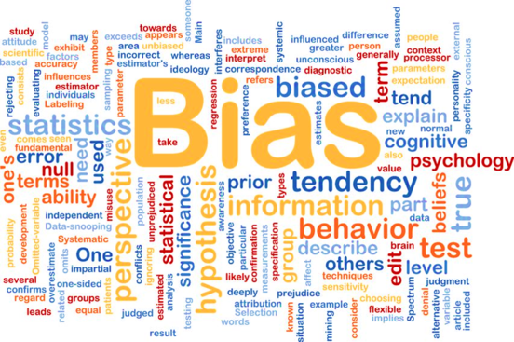
How do you spot Implicit Bias?

Slide 57
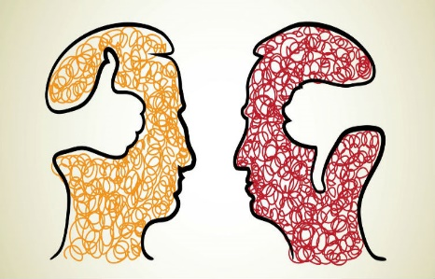
Assessments & Tests
The Implicit Association Test
  The IAT (found here https://implicit.harvard.edu/implicit/selectatest.html) measures the strength of associations between concepts (e.g., black people, gay people) and evaluations (e.g., good, bad) or stereotypes (e.g., athletic, clumsy).
  The IAT is more likely to be useful to predict system-wide discrimination versus classifying persons likely to engage in discrimination.

Slide 58
Assessments & Tests (contd.)
Gender Bias Assessment
  Assess your ability to navigate gender bias
  http://andieandal.com/assessment/IPO
  Each question in this assessment presents a situation of potential gender bias and asks you how you would deal with it.
  The assessment is framed from the perspective of a woman, so men taking it should put themselves in the position of a woman and answer the questions as if they were her.
  The assessment only takes a few minutes, it’s provocative and anonymous, and you will receive an evaluation of your answers almost immediately.

Slide 59
Implicit Bias – Hypothetical 1
Zeenat is a corporate lawyer in a corporate legal department with several years of experience.
She is discussing her career goals with her immediate supervisor where she has worked for a year.
Zeenat notes to her supervisor that she wants to be promoted in the coming months and that she’d like to know what she needs to do to be considered for promotion.
Her supervisor laughs and comments that the people who get promotions are those who have several years of tenure at the company.
Model Rules of Professional Conduct (MRPC) Rules – 1.1, 1.3, and 8.4.

Slide 60
MRPC Rule 1.1
Rule 1.1 Competence
A lawyer shall provide competent representation to a client. Competent representation requires the legal knowledge, skill, thoroughness and preparation reasonably necessary for the representation.

Slide 61
MRPC Rule 1.3
Rule 1.3 Diligence
A lawyer shall act with reasonable diligence and promptness in representing a client.

Slide 62
MRPC Rule 8.4(g)
Rule 8.4 – Misconduct
It is professional misconduct for a lawyer to:
(g) engage in conduct that the lawyer knows or reasonably should know is harassment or discrimination on the basis of race, sex, religion, national origin, ethnicity, disability, age, sexual orientation, gender identity, marital status or socioeconomic status in conduct related to the practice of law. This paragraph does not limit the ability of a lawyer to accept, decline or withdraw from a representation in accordance with Rule 1.16. This paragraph does not preclude legitimate advice or advocacy consistent with these Rules.

Slide 63
Implicit Bias – Hypothetical 2
Lucia is a patent attorney in a corporate legal department. She has worked at the company for several years.
Lucia is pregnant. She notifies her immediate supervisor that she is pregnant once she is in her second trimester.
The supervisor remarks that this is a major inconvenience and he is not sure how the legal department will cover for her while she is out on vacation for weeks.
MRPC Rule 8.4.

Slide 64
MRPC Rule 8.4(g)
Rule 8.4 – Misconduct
It is professional misconduct for a lawyer to:
(g) engage in conduct that the lawyer knows or reasonably should know is harassment or discrimination on the basis of race, sex, religion, national origin, ethnicity, disability, age, sexual orientation, gender identity, marital status or socioeconomic status in conduct related to the practice of law. This paragraph does not limit the ability of a lawyer to accept, decline or withdraw from a representation in accordance with Rule 1.16. This paragraph does not preclude legitimate advice or advocacy consistent with these Rules.

Slide 65
Implicit Bias – Hypothetical 3
There is an outspoken and direct female, junior partner, Patty, with a long history of other employees complaining about her use of profanity, crass demeanor and insensitive comments.
Others however, applaud Patty’s willingness to say what no one else is willing to say.
There is a prestigious opportunity to open a new office in an up and coming, but socially conservative city.
Patty, who is unmarried and has no children, went to law school in this city and is familiar with many of the local businesses.
The firm offers the opportunity to Frank, who is also very outspoken and blunt.
Patty is told that the firm is concerned that she is too “pushy” to be successful in this city.
Patty contacts the local EEOC field office alleging employment discrimination on the basis of sex in violation of Title VII of the Civil Rights Act of 1964.
Patty contends that men are held to a different standard when it relates to how they communicate.
MRPC Rules 1.1 & 8.4 and Title VII of the Civil Rights Act of 1964.

Slide 66
MRPC Rule 1.1
Rule 1.1 Competence
A lawyer shall provide competent representation to a client. Competent representation requires the legal knowledge, skill, thoroughness and preparation reasonably necessary for the representation.

Slide 67
MRPC Rule 8.4(g)
Rule 8.4 – Misconduct
It is professional misconduct for a lawyer to:
(g) engage in conduct that the lawyer knows or reasonably should know is harassment or discrimination on the basis of race, sex, religion, national origin, ethnicity, disability, age, sexual orientation, gender identity, marital status or socioeconomic status in conduct related to the practice of law. This paragraph does not limit the ability of a lawyer to accept, decline or withdraw from a representation in accordance with Rule 1.16. This paragraph does not preclude legitimate advice or advocacy consistent with these Rules.

Slide 68
Title VII of the Civil Rights Act of 1964
Title VII of the Civil Rights Act of 1964 is a federal law that prohibits employers from discriminating against employees on the basis of sex, race, color, national origin, and religion. It generally applies to employers with 15 or more employees, including federal, state, and local governments.

Slide 69
Implicit Bias – Hypothetical 4
A firm is hosting an end of summer picnic as a farewell to its summer associates.
A great deal of alcohol is consumed at the event.
At the end of the event a male partner, Boris, insists on driving one of the female associates, Anna, home.
The female associate is a local resident and is staying with her parents in a dangerous neighborhood.
Anna is the first person in her family to go to college and has worked hard to get academic scholarships throughout her undergraduate and law school programs.
She consistently received praise from the firm for her performance and professionalism.
At the end of the drive, Boris makes romantic advances, which Anna refuses.
The next summer she applies for a similar position with the same firm but is not selected.
She is told that the firm is concerned that she might not have the social savvy to handle their high-caliber clients.
MRPC Rules 1.1, 5.1, 8.4.

Slide 70
MRPC Rule 1.1
Rule 1.1 Competence
A lawyer shall provide competent representation to a client. Competent representation requires the legal knowledge, skill, thoroughness and preparation reasonably necessary for the representation.

Slide 71
MRPC Rule 5.1
Rule 5.1 Responsibilities Of Partners, Managers, And Supervisory Lawyers
(a) A partner in a law firm, and a lawyer who individually or together with other lawyers possesses comparable managerial authority in a law firm, shall make reasonable efforts to ensure that the firm has in effect measures giving reasonable assurance that all lawyers in the firm conform to the Rules of Professional Conduct.
(b) A lawyer having direct supervisory authority over another lawyer shall make reasonable efforts to ensure that the other lawyer conforms to the Rules of Professional Conduct.
(c) A lawyer shall be responsible for another lawyer's violation of the Rules of Professional Conduct if:
(1) the lawyer orders or, with knowledge of the specific conduct, ratifies the conduct involved; or
(2) the lawyer is a partner or has comparable managerial authority in the law firm in which the other lawyer practices, or has direct supervisory authority over the other lawyer, and knows of the conduct at a time when its consequences can be avoided or mitigated but fails to take reasonable remedial action.

Slide 72
MRPC Rule 8.4(g)
Rule 8.4 – Misconduct
It is professional misconduct for a lawyer to:
(g) engage in conduct that the lawyer knows or reasonably should know is harassment or discrimination on the basis of race, sex, religion, national origin, ethnicity, disability, age, sexual orientation, gender identity, marital status or socioeconomic status in conduct related to the practice of law. This paragraph does not limit the ability of a lawyer to accept, decline or withdraw from a representation in accordance with Rule 1.16. This paragraph does not preclude legitimate advice or advocacy consistent with these Rules.

Slide 73
Implicit Bias – Hypothetical 5
There is a prestigious opportunity to represent a cosmetics company at a firm that has been working hard to build relationships in this industry.
Helen is a top earning employee and would undoubtedly do a great job with this client.
Helen is known around the office for drinking whiskey and smoking cigars, and is frequently seen at the local sports bar with her female partner.
The firm decides to give the opportunity to Betty, a less experienced associate and former beauty pageant winner, because they feel she has more of a personal interest in the industry and will be more committed to building a lasting relationship with the client.
MRPC Rules 1.1, 1.3, 8.4.

Slide 74
MRPC Rule 1.1
Rule 1.1 Competence
A lawyer shall provide competent representation to a client. Competent representation requires the legal knowledge, skill, thoroughness and preparation reasonably necessary for the representation.

Slide 75
MRPC Rule 1.3
Rule 1.3 Diligence
A lawyer shall act with reasonable diligence and promptness in representing a client.

Slide 76
MRPC Rule 8.4(g)
Rule 8.4 – Misconduct
It is professional misconduct for a lawyer to:
(g) engage in conduct that the lawyer knows or reasonably should know is harassment or discrimination on the basis of race, sex, religion, national origin, ethnicity, disability, age, sexual orientation, gender identity, marital status or socioeconomic status in conduct related to the practice of law. This paragraph does not limit the ability of a lawyer to accept, decline or withdraw from a representation in accordance with Rule 1.16. This paragraph does not preclude legitimate advice or advocacy consistent with these Rules.

Slide 77
Implicit Bias – Hypothetical 6
A firm is interviewing for business with a high-profile Japanese technology company.
The firm has a second year associate, Tony, in Mergers & Acquisitions who is Japanese-American.
They ask Tony to deliver the pitch to the tech company.
After he completes the assignment he confides in his mentor that he felt a bit used because he has never expressed any interest in Intellectual Property Law and was clearly not the most qualified person for the job.
MRPC Rules 1.1, 1.3, 8.4

Slide 78
MRPC Rule 1.1
Rule 1.1 Competence
A lawyer shall provide competent representation to a client. Competent representation requires the legal knowledge, skill, thoroughness and preparation reasonably necessary for the representation.

Slide 79
MRPC Rule 1.3
Rule 1.3 Diligence
A lawyer shall act with reasonable diligence and promptness in representing a client.

Slide 80
MRPC Rule 8.4(g)
Rule 8.4 – Misconduct
It is professional misconduct for a lawyer to:
(g) engage in conduct that the lawyer knows or reasonably should know is harassment or discrimination on the basis of race, sex, religion, national origin, ethnicity, disability, age, sexual orientation, gender identity, marital status or socioeconomic status in conduct related to the practice of law. This paragraph does not limit the ability of a lawyer to accept, decline or withdraw from a representation in accordance with Rule 1.16. This paragraph does not preclude legitimate advice or advocacy consistent with these Rules.

Slide 81
Implicit Bias – Hypothetical 7
Mark and Ray, who are both first year associates in a law firm, are chatting in a conference room waiting for the partners to arrive before a litigation conference call with a client.
Mark mentions how he is worried about his mom who might be evicted from her rental because she has been having some issues with substance abuse.
One of the partners walks into the conference room as Ray laughs and comments that a bit of drug use never hurt anyone.
MRPC 1.1, 1.3, 5.1, 8.4.

Slide 82
MRPC Rule 1.1
Rule 1.1 Competence
A lawyer shall provide competent representation to a client. Competent representation requires the legal knowledge, skill, thoroughness and preparation reasonably necessary for the representation.

Slide 83
MRPC Rule 1.3
Rule 1.3 Diligence
A lawyer shall act with reasonable diligence and promptness in representing a client.

Slide 84
MRPC Rule 5.1
Rule 5.1 Responsibilities Of Partners, Managers, And Supervisory Lawyers
(a) A partner in a law firm, and a lawyer who individually or together with other lawyers possesses comparable managerial authority in a law firm, shall make reasonable efforts to ensure that the firm has in effect measures giving reasonable assurance that all lawyers in the firm conform to the Rules of Professional Conduct.
(b) A lawyer having direct supervisory authority over another lawyer shall make reasonable efforts to ensure that the other lawyer conforms to the Rules of Professional Conduct.
(c) A lawyer shall be responsible for another lawyer's violation of the Rules of Professional Conduct if:
(1) the lawyer orders or, with knowledge of the specific conduct, ratifies the conduct involved; or
(2) the lawyer is a partner or has comparable managerial authority in the law firm in which the other lawyer practices, or has direct supervisory authority over the other lawyer, and knows of the conduct at a time when its consequences can be avoided or mitigated but fails to take reasonable remedial action.

Slide 85
MRPC Rule 8.4(g)
Rule 8.4 – Misconduct
It is professional misconduct for a lawyer to:
(g) engage in conduct that the lawyer knows or reasonably should know is harassment or discrimination on the basis of race, sex, religion, national origin, ethnicity, disability, age, sexual orientation, gender identity, marital status or socioeconomic status in conduct related to the practice of law. This paragraph does not limit the ability of a lawyer to accept, decline or withdraw from a representation in accordance with Rule 1.16. This paragraph does not preclude legitimate advice or advocacy consistent with these Rules.

Slide 86
Implicit Bias – Hypothetical 8
Tom is interviewing a prospective client – a dark-skinned woman wearing a head scarf.
The prospective client’s name is Reshma Maliki.
Halfway through the interview, Tom tells her that he is done talking to her, he would never represent her because it just wouldn’t be a good fit.
What biases apply here?
What if, unbeknownst to Tom, Reshma is a Baptist, who is wearing the head scarf to cover her hair loss from her chemotherapy treatments?

Slide 87
Implicit Bias – Hypothetical 9
Hiring managers Lisa and Jay go through dozens of resumes to fill a position for in-house patent counsel.
While going through the resumes, they separate all resumes into two stacks – the first stack with resumes having Caucasian-sounding names and the second stack with resumes having “ethnic” sounding names.
They decide they will focus on interviewing candidates from the first stack and then interview a couple of the best candidates from the second stack to “meet quota” requirements.
What biases and problems do you see here?

Slide 88
Implicit Bias – Hypothetical 10
Josh is a senior ranking litigation partner in a law firm. He has organized a golf outing for everyone at the firm.
Joan is a senior litigation associate at the firm and is a mom to a 6-month old baby girl. She would like to attend the golf outing but is unable to attend at the last minute because she has to stay home with her sick baby girl. Her husband is unable to cover for her because he is traveling for business.
During the golf outing, Josh assigns a new high profile litigation matter to the three associates on his team while golfing. All three associates are single and do not have kids.
MRPC 1.1, 1.3, and 8.4.

Slide 89
MRPC Rule 1.1
Rule 1.1 Competence
A lawyer shall provide competent representation to a client. Competent representation requires the legal knowledge, skill, thoroughness and preparation reasonably necessary for the representation.

Slide 90
MRPC Rule 1.3
Rule 1.3 Diligence
A lawyer shall act with reasonable diligence and promptness in representing a client.

Slide 91
MRPC Rule 8.4(g)
Rule 8.4 – Misconduct
It is professional misconduct for a lawyer to:
(g) engage in conduct that the lawyer knows or reasonably should know is harassment or discrimination on the basis of race, sex, religion, national origin, ethnicity, disability, age, sexual orientation, gender identity, marital status or socioeconomic status in conduct related to the practice of law. This paragraph does not limit the ability of a lawyer to accept, decline or withdraw from a representation in accordance with Rule 1.16. This paragraph does not preclude legitimate advice or advocacy consistent with these Rules.

Slide 92
Gender Discrimination Lawsuits
Doe v. Proskauer Rose, LLP (1:17-cv-00901), District Of Columbia District Court; Filed: 05/12/2017
  A partner in Proskauer’s Washington, D.C., office sued the firm in federal court, alleging she is a victim of discrimination and claiming “substantial gender disparities” in the firm’s partnership.
  The suit claims at least $50 million in damages.
Campbell et al. v. Chadbourne & Parke LLP et al. (1:16-cv-06832), U.S. District Court for the Southern District of New York; Filed 08/31/2016
  Kerrie Campbell, a female litigation partner at Chadbourne & Parke in Washington, D.C., who last year filed a $100 million gender discrimination suit against the firm, was expelled from its partnership in April 2017.

Slide 93

How can we de-bias?

Slide 94
De-biasing Tips
Recognize
Unconscious Selves at Work
Who am I?
Who’s like me?
Confirmation Bias
Micro-Affirmations
Micro-Inequities
Where am I getting my information?
Overcome
Acknowledge/value differences (perspectives, backgrounds, cultures, experiences, ideologies)
Encourage connections
Provide clear & constructive feedback
Build relationships
Practice effective communication
Be mindful

Slide 95
De-biasing Tips
Offer Implicit Bias workshops to employees to identify biases and then create de-biasing procedures.
Examples of de-biasing procedures:
  During hiring, remove any references to gender and/or race from resumes.
  During the hiring process, consider using voice modulation to mask gender during first round of interviews.
  To increase retention of women and minorities, encourage matching with sponsors.
  To increase retention of women and minorities, offer clear and constructive feedback with clear steps for career advancement.
  To increase retention of women and minorities, create a succession plan that is inclusive.

Slide 96

De-biasing Tips
Be Mindful
  How do I select team members for a project?
  Who do I like to work with on projects?
  Who do I tend to bond with more?
  Do I generally converse only with the same people?
  How do I identify candidates for promotion and succession?
  Am I creating opportunities for those less extroverted to demonstrate their capabilities equally?
  Who do I tap for the lead role?

Slide 97

De-biasing Tips
  Have I gotten to know more about my colleagues?
  Do I avoid working with certain colleagues because of their work style or ideological approach?
  Have I avoided sharing my thoughts or ideas because I don’t think they are worthy to share?

Slide 98

De-biasing Tips
  What assumptions, if any, am I making in this situation?
  Do I typically hire the same type of person, or personality type?
  Which of my past hires were successful, and what can I learn from those choices that didn’t work out as well?

Slide 99
De-biasing Tips
Social contact: Meaningful intergroup interactions allow us to find connections or links to people we might normally not interact with.
Cuing Positive Exemplars: Exposing people to positive stories and images that counter negative stereotypes.
Counter stereotype Training: Targeting a negative stereotype and explaining the inaccuracy of it with constant reinforcement.

Slide 100
Gender Balance System Design [GBSD]:
A Nudging Strategy

Slide 101
GBSD: A Nudging Strategy

Slide 102

Conclusions

Slide 103
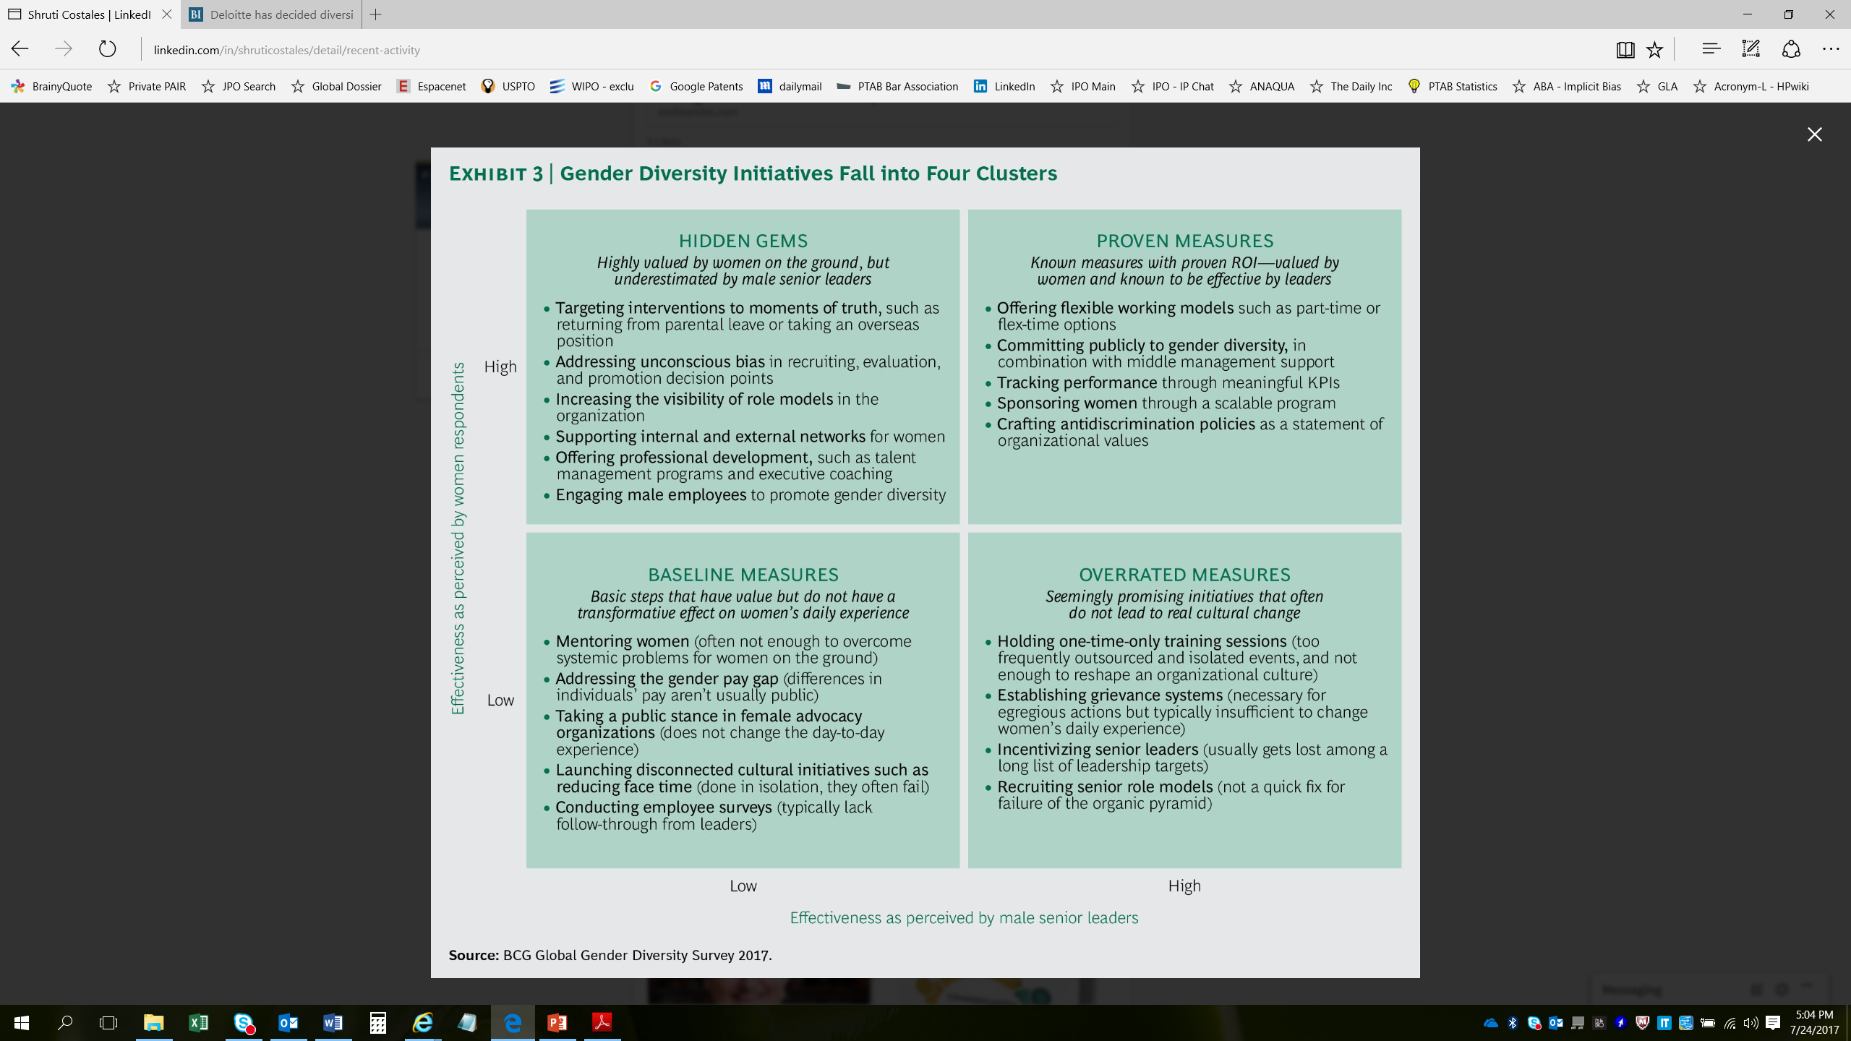
Hidden Gems

Slide 104
Diversity’s Dividend

Slide 105

Questions?

