Slide 1
Intellectual Property Owners Association

Slide 2
We are IP OWNERS
Members in 37 countries
~200 corporate members from all industries and fields of technology including:
AbbVie Apple, Inc. 3M Innovative Properties Co. Bristol-Myers Squibb Co. Caterpillar Inc. Exxon Mobil Corp. Ford Global Technologies LLC Google Inc. Illinois Tool Works Huawei Technologies | Intellectual Ventures Management, LLC Koch Industries Inc. Lockheed Martin Monsanto Co. Mars Inc. Nike, Inc. Siemens Unilever Visa Inc.
For a full list of IPO member companies, go to www.ipo.org/corporatemembers.

Slide 3
Key priorities
Advocate for IP rights
Educate U.S. policy makers and key influencers on the value of IP
Execute strategy to address erosion of IP rights in the U.S. by restoring high quality, reliable, and enforceable IP rights
Shape IP policy and rights relating to emerging technologies
Advocate for IP rights internationally
Deliver a strong value proposition for all members

Slide 4
Advocating for you
Comments filed with IP offices and administrative agencies (2017)
United States
U.S. Patent and Trademark Office
U.S. Copyright Office
U.S. Trade Representative
U.S. Department of State
Library of Congress
Abroad
Legislative Affairs Commission of the People’s Republic of China
State Council Anti-Monopoly Commission of the People’s Republic of China
Brazil’s National Institute of Industrial Property
Innovation, Science and Economic Development Canada

Slide 5
Advocating for you
Amicus Briefs (2017)
United States
U.S. Court of Appeals for the Federal Circuit
U.S. Supreme Court
Supreme Court of Texas
Abroad
European Patent Office Enlarged Board of Appeal
Supreme Court of Canada

Slide 6
Advocating for you
Board resolutions dictate positions IPO advocates to government leaders at in-person meetings, in formal testimony, and in letters and comments.
2017 resolutions address:
The standard for awarding attorney fees in patent suits
Codifying laches defense in patent litigation
Subject matter eligibility
IPO was the first IP organization to pass a resolution supporting legislation to amend U.S. Patent Act section 101 concerning patent subject matter eligibility to address recent U.S. Supreme Court decisions that have dramatically narrowed the scope of patent protection and caused tremendous uncertainty for many investing in innovation. A background report on IPO’s position is available here.

Slide 7
Why membership matters
IPO works to serve the best interests of owners of intellectual property. We advocate positions developed by committees of members. Your voice matters! All IP owners are needed at the table to ensure IPO advocates for policies, practices, and laws that encourage and support innovative businesses and economies.

Slide 8
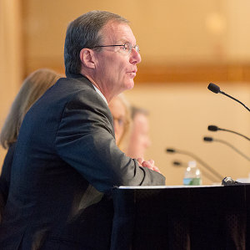
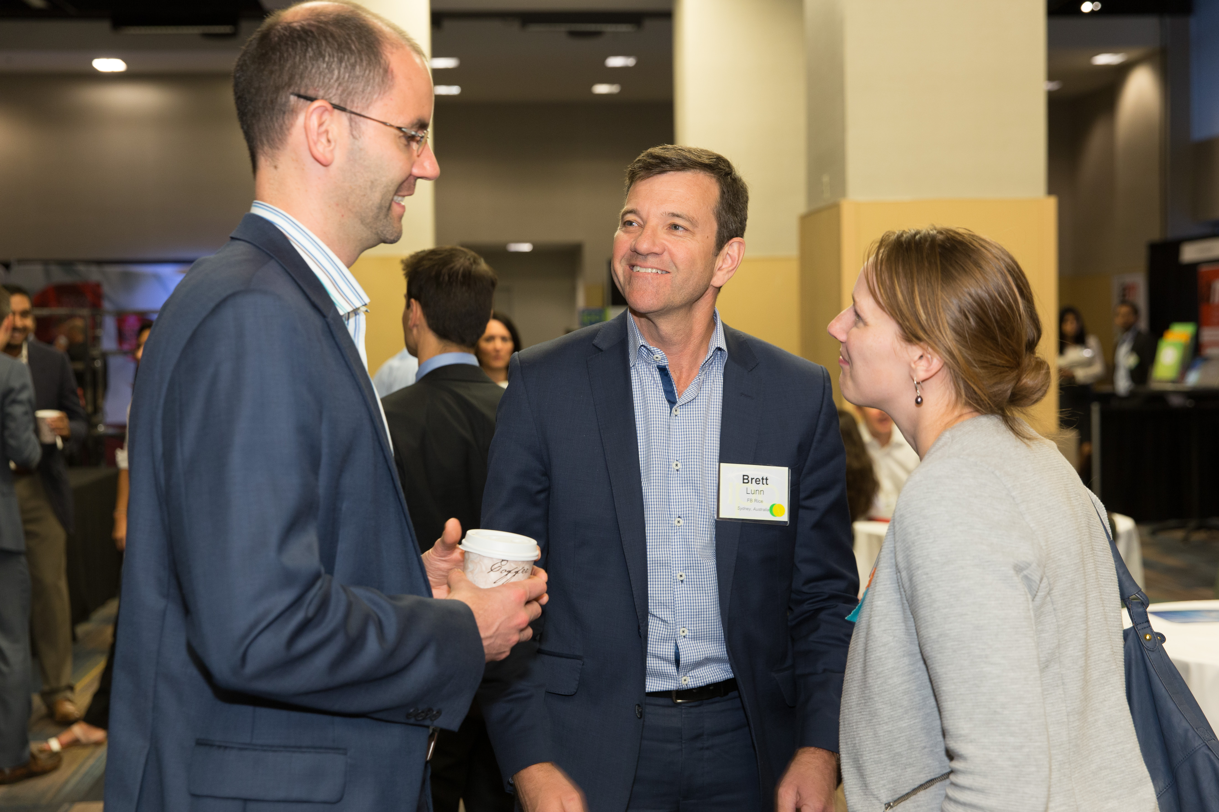
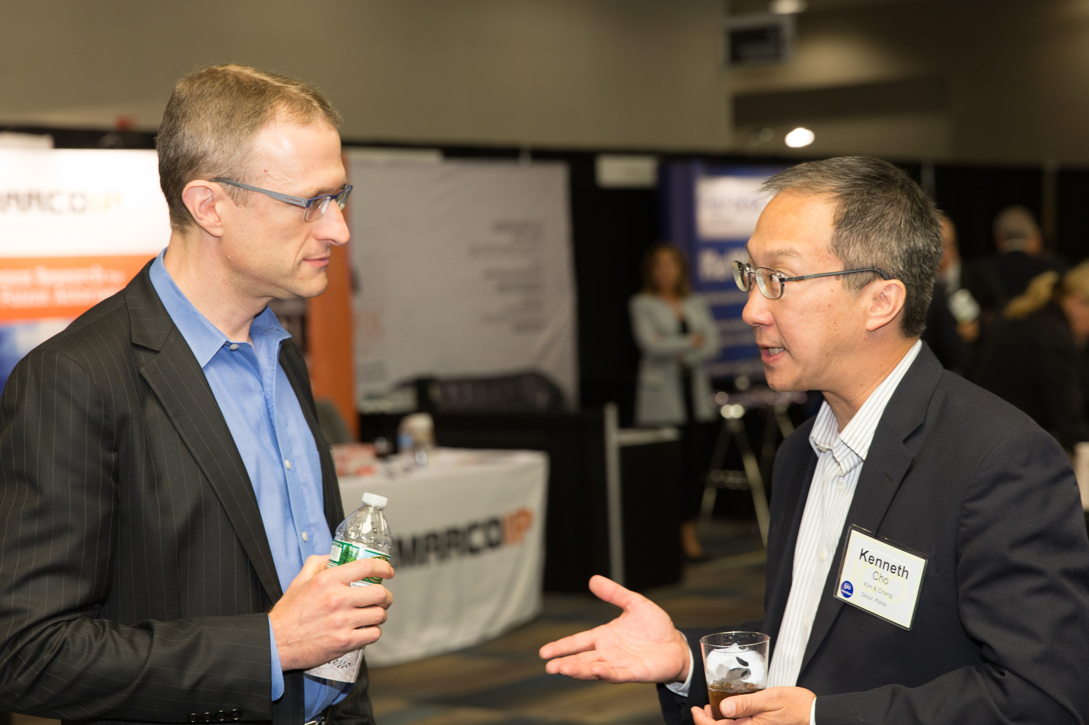
Benefits of membership
Your company’s membership covers all employees worldwide.
As a member, your team will have the opportunity to participate in IPO committees and shape IPO’s advocacy work.

Slide 9
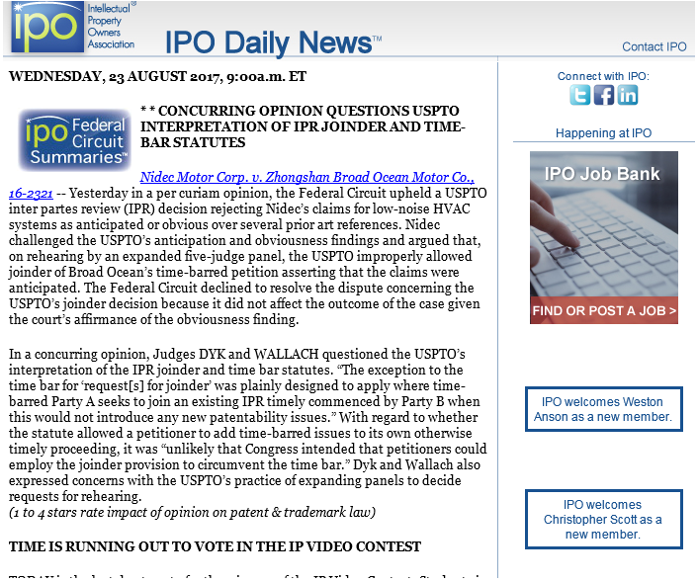
Benefits of membership
Quickly stay up to date on the latest happenings in the IP community and IP policy globally through the IPO Daily NewsTM, featuring IPO’s Federal Circuit SummariesTM, and the Corporate Monthly newsletter.

Slide 10
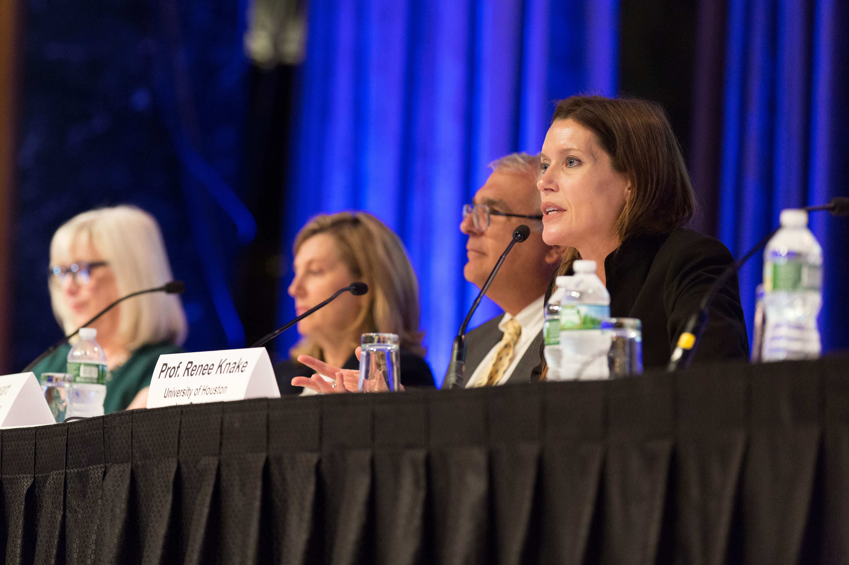
Benefits of membership
Earn high quality CLE credit through in-person meetings and events and IP Chat ChannelTM weekly webinars.
Annual passes for the IP Chat Channel are available for corporate members of IPO for $6,000 (regularly $135 per webinar).

Slide 11
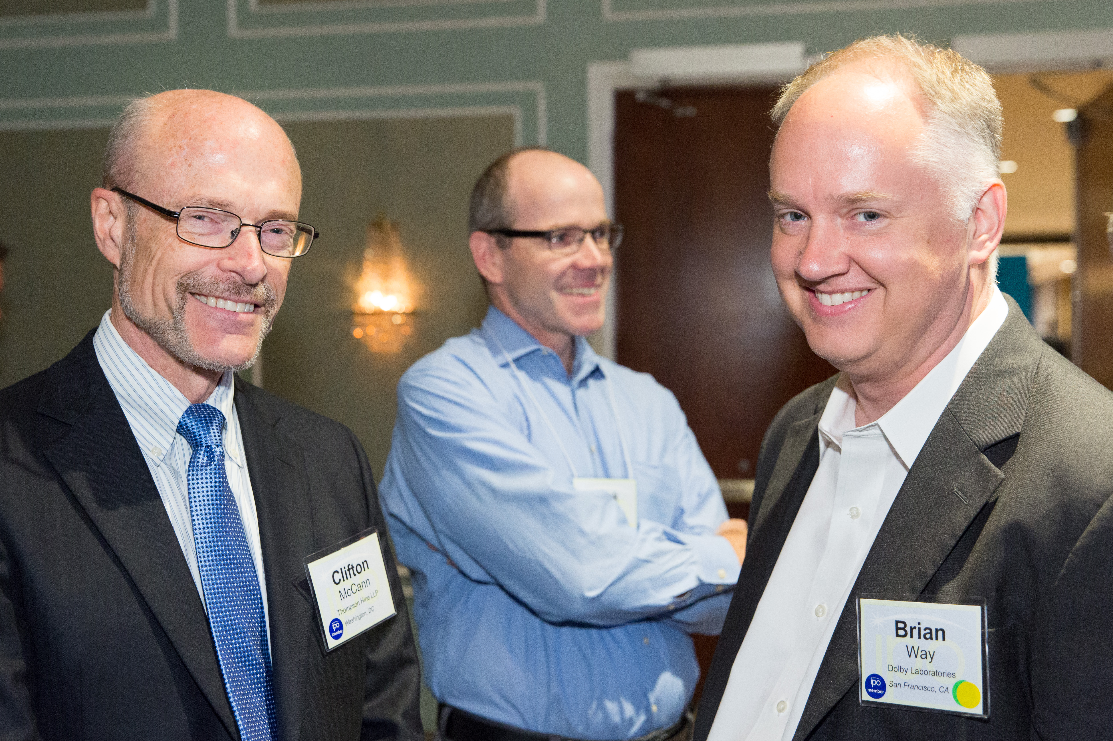
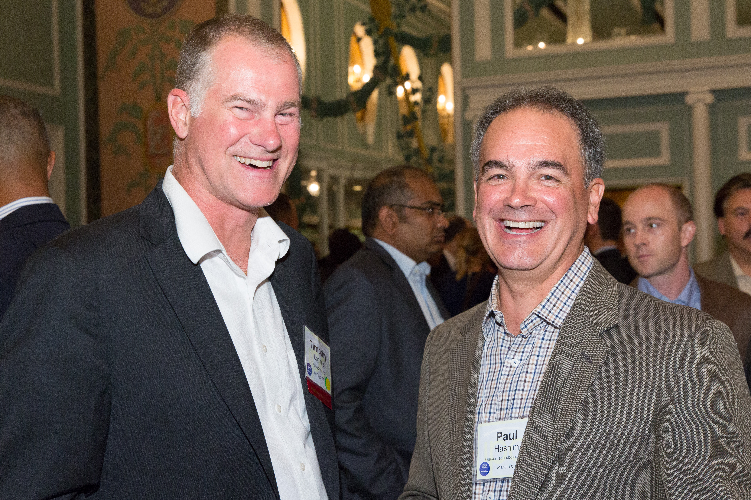
Benefits of membership
Network! Get to know and share best practices with in-house counsel from other corporate member organizations

Slide 12
Benefits of membership
Professional development! All IPO committees are chaired by individuals from corporate member organizations – an excellent leadership opportunity.
The Corporate IP Management Committee conducts regular studies on best practices and publishes the results for IPO members.
Get to know and share best practices with other corporate in-house counsel.
The Women in IP Law Committee publishes toolkits for women within the IP law profession and hosts a networking breakfast at the IPO Annual Meeting.
Also at the IPO Annual Meeting, there is a networking breakfast exclusively for chief IP counsel.

Slide 13
Benefits of membership
Opportunity to serve on the Board of Directors – IPO is governed by a board of 50 corporate chief IP counsel
44 sustaining members are elected for two-year terms that may be renewed for an unlimited number of terms. These members pay higher dues once they are elected to a sustaining position. See next slide.
5 regular corporate members are elected for two-year terms that may not be renewed for a consecutive term. These members pay the same dues as all corporate members. See next slide.
1 inventor member
Click here to hear from our members why they are actively involved in IPO!

Slide 14
Join IPO Today!
Corporate membership dues are paid on an annual basis. Dues are as follows:
Regular Corporate Members
R1 – 10 or more patents received last year - $6,850
R2 – Fewer than 10 patents received last year - $4,550
R3 – Fewer than 10 patents received last year and less than $5B in annual sales - $2,350
Sustaining Corporate Members
S1 – Greater than $50B in annual sales - $34,450
S2 -- $10-50B in annual sales - $26,800
S3 – Less than10B in annual sales - $19,150

